Slide 1
HP TEAM FOR THAILAND MITIGRATION PROJECT
LEVERAGING MY EXPERTISE TO DRIVE STRATEGIC SUCCESS
PRESENTED BY
DR. DENNIS ANKOMAH
DATE:- 01-19-2025

Slide 2
PROJECT OBJECTIVE
To establish HP’s notebook PC production base in Thailand, leveraging its strategic advantages to enhance operational efficiency, market presence, and profitability.
Key Goals
Mitigate supply chain risks and geopolitical challenges.
Optimize production costs while maintaining quality standards.
Expand HP’s market presence in Southeast Asia.

Slide 3
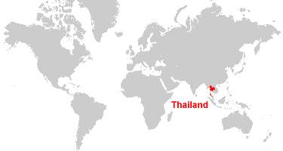
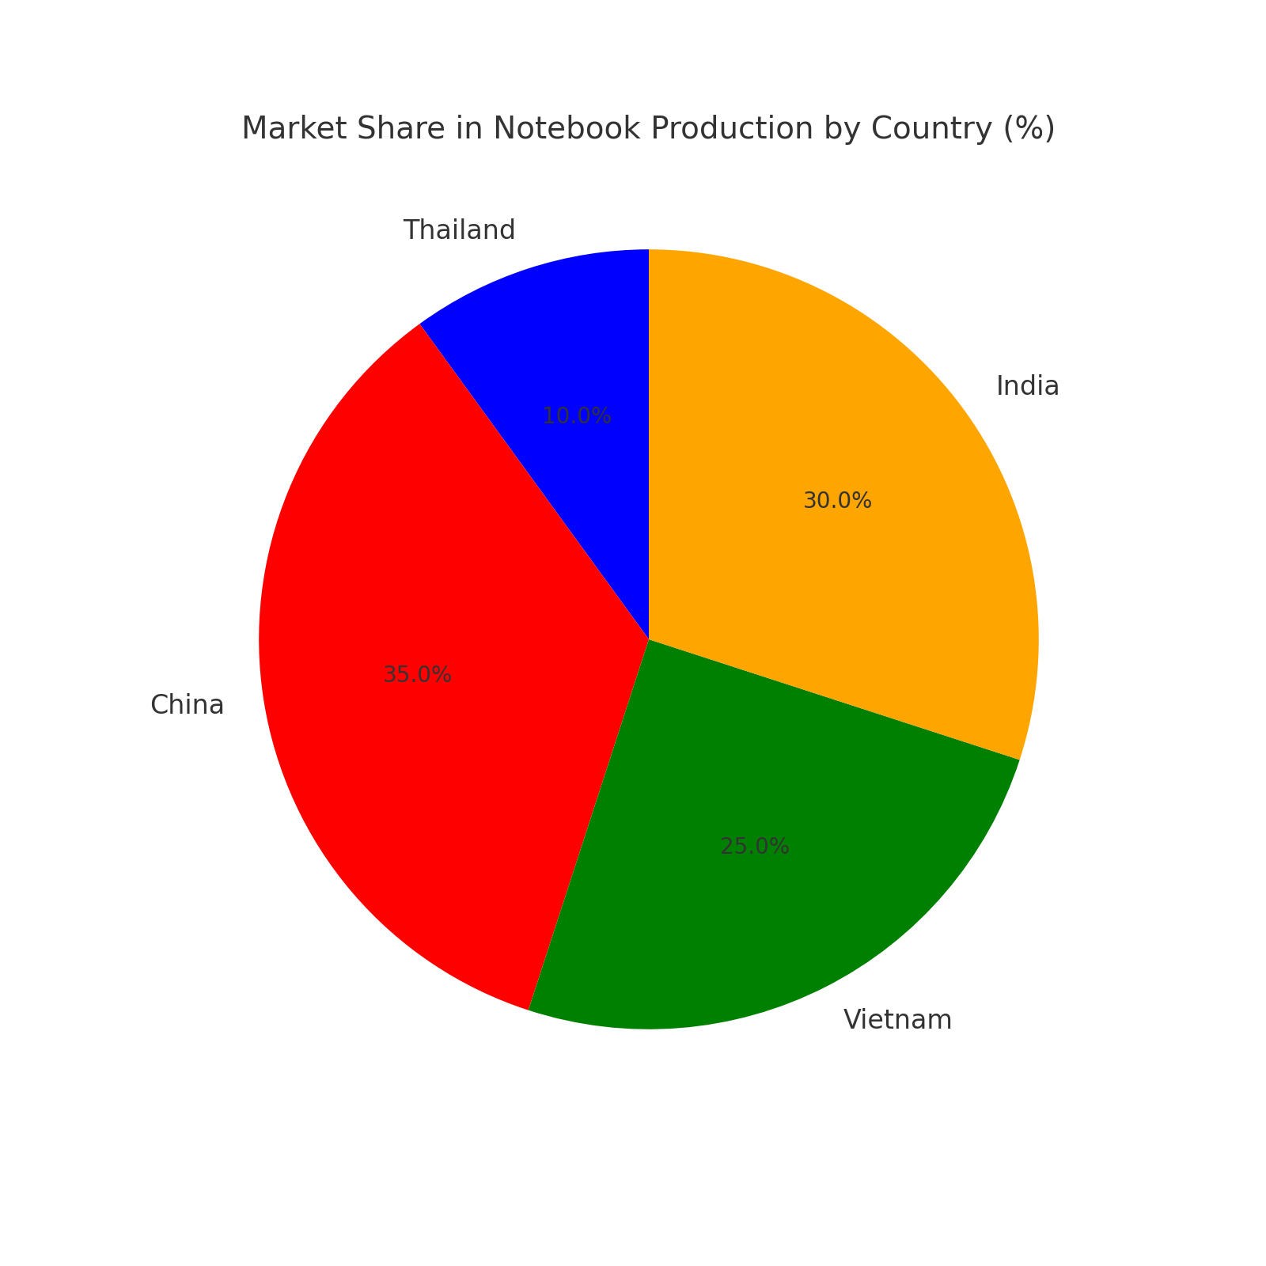
WHY THAILAND
STRATEGIC LOCATION
Proximity to major markets in Southeast Asia.
Efficient export logistics with access to global shipping routes.

Slide 4
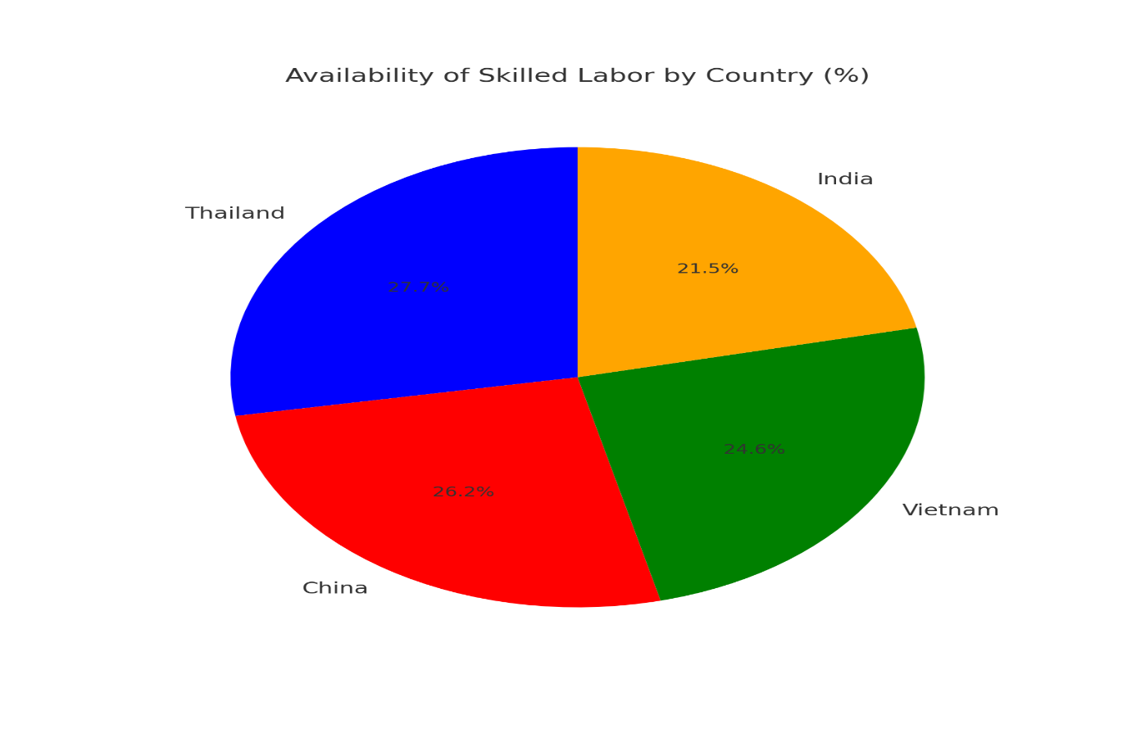
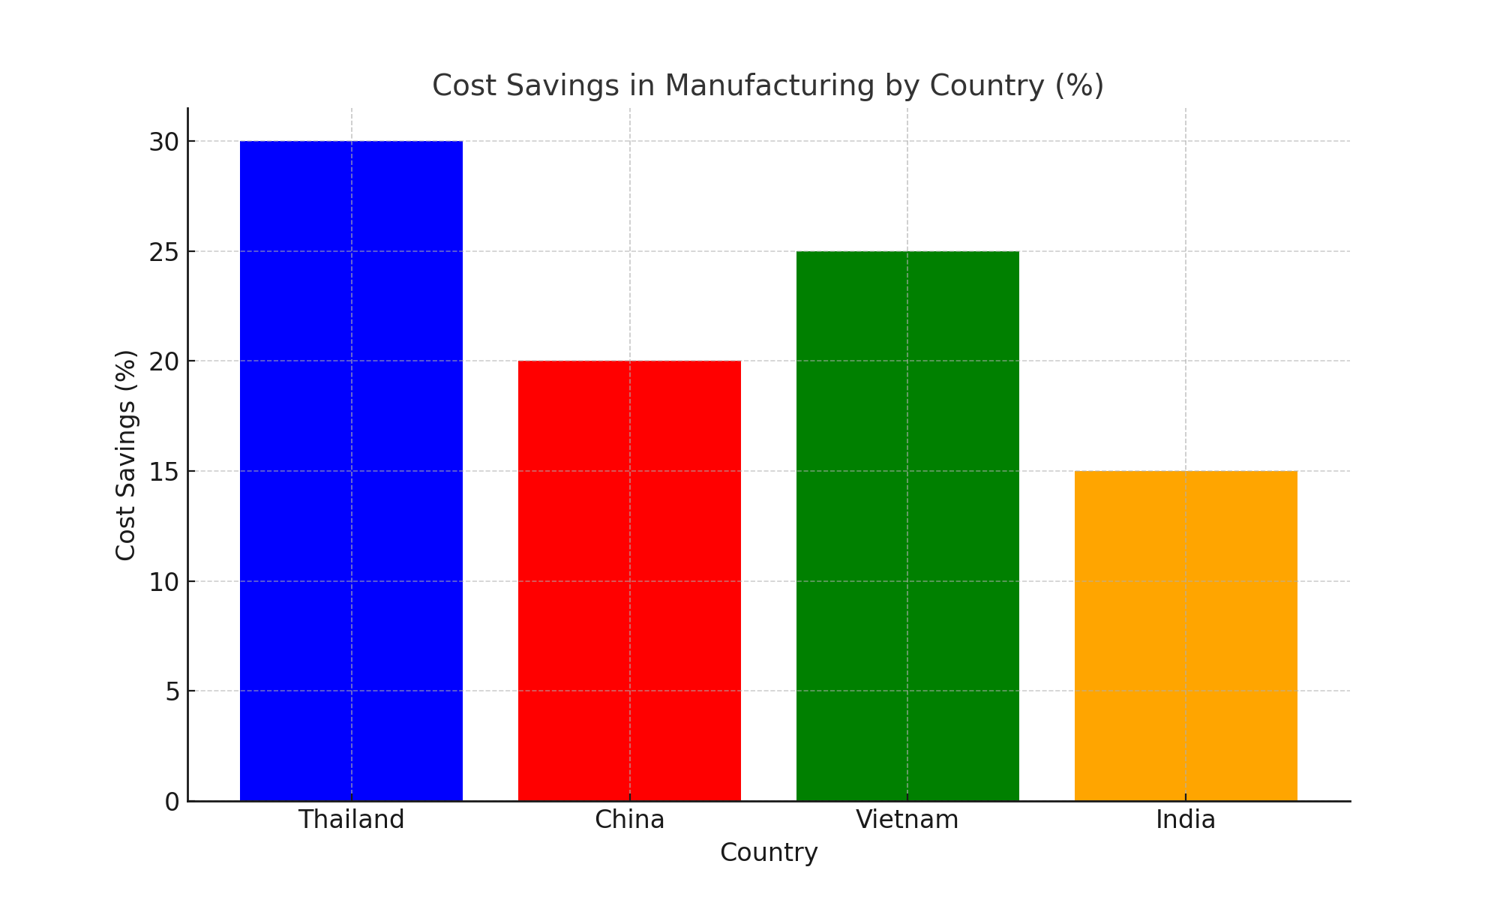
WHY THAILAND
2. COST-EFFECTIVE MANUFACTURING:
Competitive labor costs compared to developed nations.
Availability of skilled labor in tech manufacturing.

Slide 5
WHY THAILAND
3. GOVERNMENT SUPPORT:
Investment-friendly policies, including tax incentives.
Thailand’s push towards becoming a regional manufacturing hub.
4. INFRASTRUCTURE:
Established industrial zones and modern facilities.
Reliable transportation and logistics networks.

Slide 6
PROPOSED ROADMAP TO SUCCESS (KEY MILESTONES)
PHASE 1: INITIAL SETUP AND RESEARCH
Establish local partnerships with suppliers and logistics providers.
Conduct market analysis to understand local consumer preferences and competitors.
Identify regulatory requirements and ensure compliance.
PHASE 2: INFRASTRUCTURE DEVELOPMENT
Set up manufacturing facilities in strategic locations within Thailand.
Recruit and train a skilled local workforce.
Implement advanced production technologies to enhance efficiency and quality.
PHASE 3: PRODUCT LAUNCH PREPARATION
Develop marketing campaigns tailored to the Southeast Asian market.
Collaborate with local retailers and e-commerce platforms for distribution.
Conduct pilot production runs to test processes and ensure product quality.
PHASE 4: MARKET PENETRATION AND SCALING
Launch products with competitive pricing and localized features.
Monitor customer feedback and adapt strategies as needed.
Expand distribution networks and production capacity based on demand.

Slide 7
FEATURES REQUIREMENTS
1. Localized Product Features:
Language Support: Ensure software and hardware interfaces support Thai and other regional languages.
Power Compatibility: Adapt devices to local power requirements, including voltage and plug types.
Cultural Customization: Integrate features relevant to local practices, such as thermal resistance for tropical climates.
2. Sustainability:
Material Selection: Use recyclable materials and minimize plastic use in product design.
Energy Efficiency: Equip devices with low-power consumption features and promote energy-saving modes.
Sustainable Packaging: Utilize biodegradable or recyclable materials for packaging, reducing environmental impact.
3. Quality Assurance:
Testing Protocols: Conduct rigorous testing under local environmental conditions (e.g., humidity, heat) to ensure durability.
Defect Prevention: Implement Six Sigma methodologies to reduce defects during production.
Certifications: Achieve local and international certifications, such as ISO 9001 for quality management.

Slide 8
FEATURES REQUIREMENTS
1. COST EFFICIENCY:
Lean Manufacturing: Adopt lean production techniques to minimize waste and optimize resource use.
Local Sourcing: Leverage local suppliers to reduce logistics and material costs.
Automation: Introduce robotics and AI in manufacturing to increase efficiency and lower labor costs.
2. CUSTOMER SUPPORT:
Localized Help Desks: Set up support centers with multilingual staff fluent in regional languages.
Online Support Tools: Develop AI-driven chatbots and knowledge bases tailored to regional needs.
Service Accessibility: Ensure easy access to service centers across Thailand and nearby regions.
3. TECHNOLOGY INTEGRATION:
Smart Manufacturing: Use IoT sensors for real-time monitoring of production lines.
Big Data Analytics: Implement analytics to forecast demand, optimize supply chains, and enhance decision-making.
Cloud Integration: Utilize cloud platforms for seamless communication and operational efficiency.
4. SCALABILITY:
Modular Facilities: Design factories with modular layouts to allow quick expansion when needed.
Market Readiness: Develop a strategy to enter additional Southeast Asian markets, such as Malaysia and Indonesia.
Training Programs: Create ongoing training initiatives to upskill workers as operations expand.

Slide 9
SUCCESS METRICS
Achieve a 20% reduction in production costs within the first year.
Capture 25% of the Southeast Asian market share within three years.
Attain a customer satisfaction score of 90% or higher.
Ensure 100% compliance with local and international regulations.

Slide 10
THANK YOU

